Slide 1
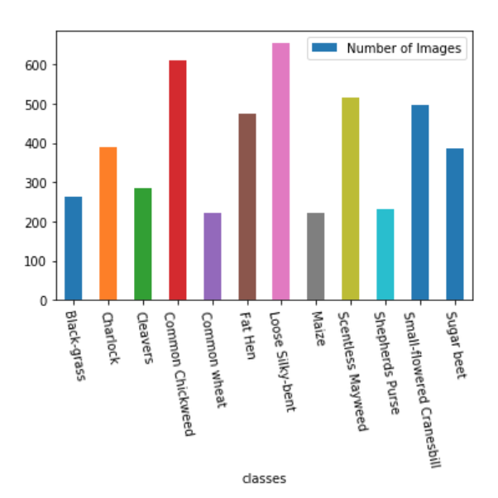
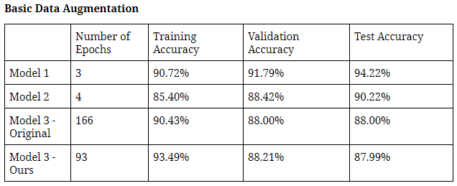
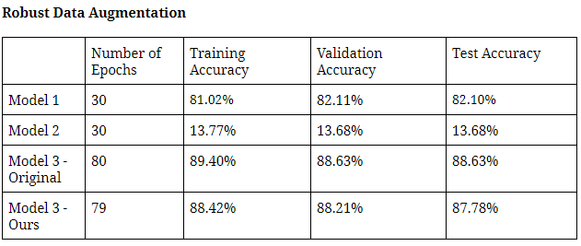
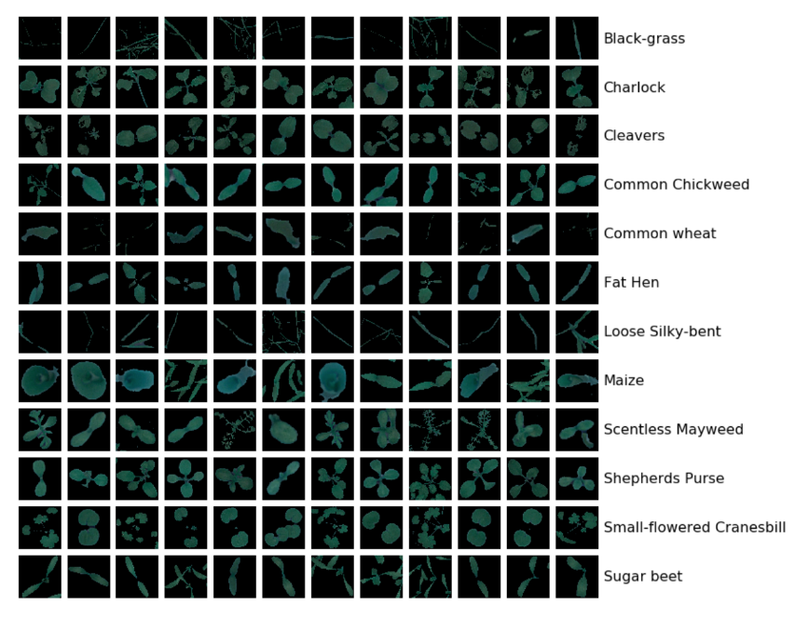
Plant Seedlings Classification
50.035 Computer Vision
Pamela Wang, Tai Hong Wen
Singapore University of Technology and Design
Background and Motivation
In agriculture, weeds compete for sunlight and nutrients in the soil, which can lead to stunted growth of other plants. Identifying and removing these weeds can be a tedious and time-consuming process for farmers. As such, an image classification solution that can effectively differentiate plants from weeds could potentially ease the farmers’ job and improve crop yields. Such a solution can also be integrated with automated robotic farming: developing a robot to automatically detect and remove weeds.
System Design and Experiment Results
We tried 3 different models. For each model, we evaluated it based on the results obtained from training the model for 50 minutes on Kaggle with a GPU enabled. We tried running each model with a basic data augmentation function and a data augmentation function.
Model 1: Basic model. Initial layers learn primitive features, while later layers learn high level features so increased filter size for later layers. 3 hidden layers for Fully Connected Net at the end.
Model 2: Basic model replacing max pooling layers with convolution layers.
Model 3: Simplest model, using RMSprop optimizer and annealing learning rate
Dataset
The dataset used in this project is released by the Aarhus University Signal Processing group, in collaboration with University of Southern Denmark and consists of images of approximately 960 unique plants belonging to 12 species at several growth stages.
Data Augmentation
Model 1 performed best for the standard seedling pictures
We generated more images to ease the imbalance in the dataset. We also performed a robust data augmentation to generalize and classify images under different illumination conditions, viewpoints and only part of the seedling shown.
Basic: Slight rotation, zoom and shifts to the image. Optimal configuration for best testing accuracy.
Robust: Slight zoom and shifts, with 180 degree rotation and flips. This will make model robust against images with different conditions.
Model 2 performed well for the standard seedling pictures, but not the varied dataset. This might be due to unbalanced data and model 2 being unsuited for this problem
Image Preprocessing
Image masking was used to remove the background so that the model is only looking at the shape of the seedings:
Model 3 performed best for the varied dataset
Conclusion and Insights
Future Work
A model with more parameters has more representative power but this might not necessarily lead to training a more accurate model as shown by model 2.
Filter size increase works to increase the representative power of the models and can improve accuracy more than running the network for more epochs as shown by model 1 being more accurate than model 3.
Replacing Max Pooling with Convolution Layers did not help improve our model as shown by comparing model 1 with model 2.
Unbalanced data could lead to a model not learning any features and instead only predicting one class.
Further fine-tuning of hyperparameters: learning rate, optimizer
Possibly running layers with different filter sizes to improve training speed and accuracy of the model

